Slide 1
Reactive programming over wire

Slide 2
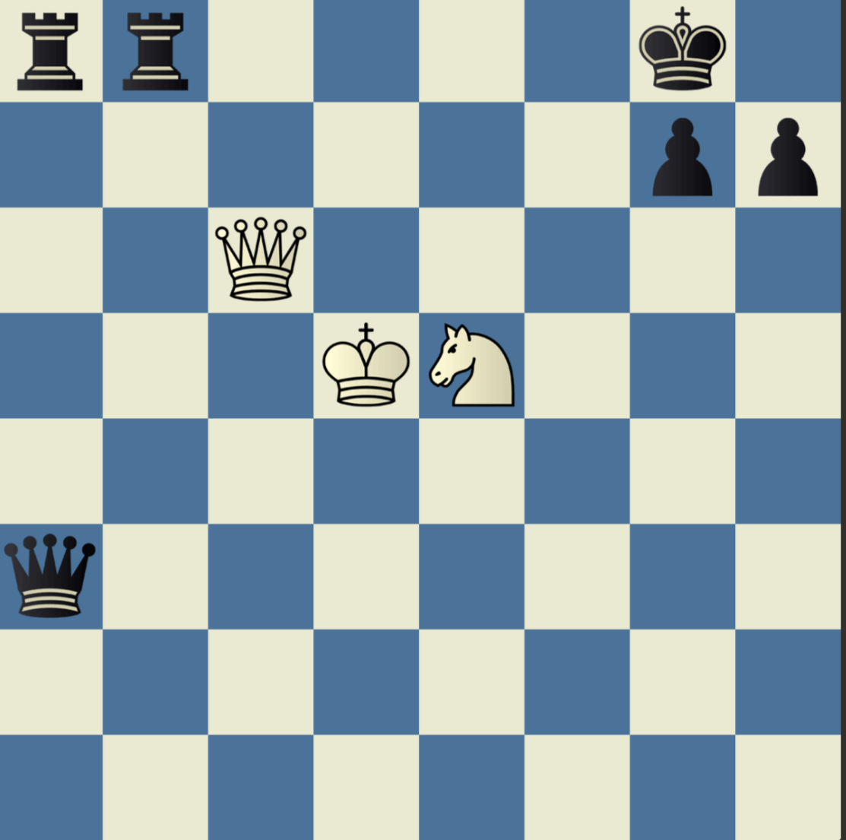
Patterns

Slide 3
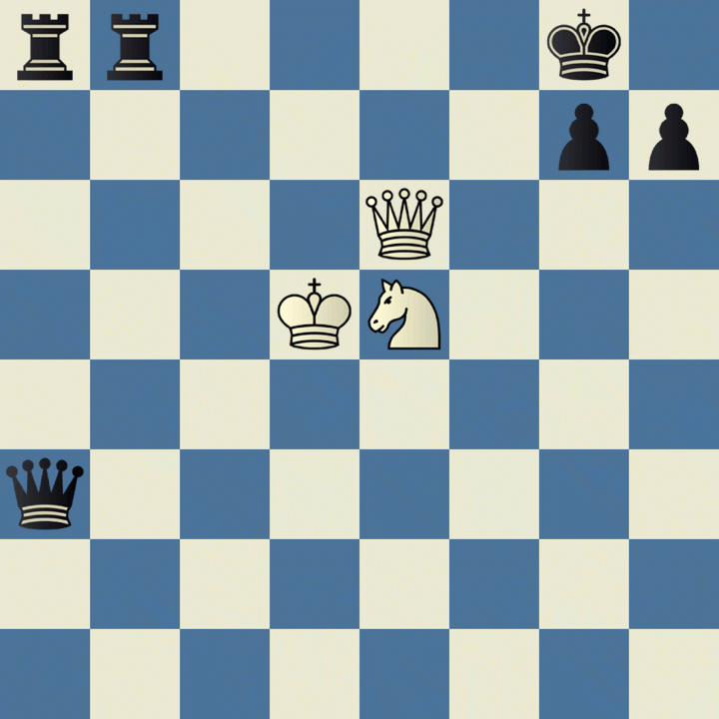
Patterns: Smothered Mate

Slide 4

Patterns
Good up to a certain level
Magnus Carlsen
Understand how pieces coordinate together
Fun fact: I have more chess experience than Magnus, according to HR I should be destroying him

Slide 5

All about protocols
SOLID, design patterns, DRY…
This will get you only so far…
We can follow all these principles and still have problematic systems
Not enough attention from the industry
What to learn?
TCP vs new javascript framework
Remember Angular1

Slide 6
The Reactive Manifesto
Came out in ~ 2014
https://www.reactivemanifesto.org/
Came out as a reaction to mechanical sympathy blog
https://mechanical-sympathy.blogspot.com/
https://groups.google.com/forum/#!forum/mechanical-sympathy

Slide 7
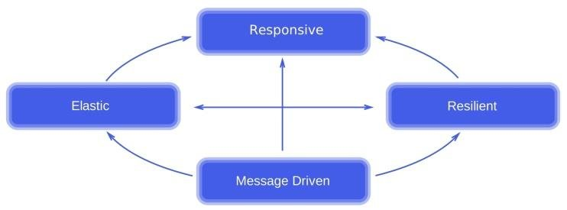
The Reactive Manifesto
Responsive
Resilient
Elastic
Message driven

Slide 8
Reactive streams
Set of interfaces
Test bench for implementation
https://github.com/reactive-streams/reactive-streams-jvm
Many implementations
Reactor Vert.x Akka RxJava …
http://www.reactive-streams.org/
https://github.com/reactive-streams/reactive-streams-jvm

Slide 9
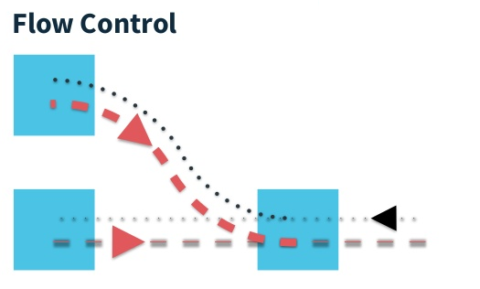
Flow control

Slide 10

Flow control

Slide 11
Reactor
Implementation of reactive socket
Pivotal sponsored but has nothing to do with spring
Example from search control

Slide 12

Reactor over network ?
Problem: we are bounded to do reactor inside one process
What if we have more than one process?
Each system inside might be well designed but as a whole system is still *problematic
We are hardly building isolated systems

Slide 13
Programming over network ?
Lousy protocols make lousy systems
Hard to do proper communication -> fallback to request response
Lack of efficiency introduce lots of not needed complexity
Bad encodings create all sort of problems

Slide 14


Programming over network ?
Lots of systems in 2019:
Json + http 1.1
Http was designed for static document-based retrieval not for modern based systems
Http 2 a bit better but still designed for resource retrieval

Slide 15



Interaction models
Request response
Fire and forget
Request stream
Bi-directional communication
How many of these can we do with HTTP ?

Slide 16
Interaction models
Relevant for API/Contract design
Communication pattern -> interface
Implementation :
Programming model
Message passing
Thread synchronization
ConcurrentHashMap -> shared memory communication
Java collections framework -> api design

Slide 17

Encodings
Binary protocol !?
Has only 2 states !?
As of 2019 computers are not working on English alphabet
“Binary” vs “ human readable” protocol
UTF8 lots of tools around illusion of “human readable”
Binary encoding can transmit textual content

Slide 18
Rsocket
Application level protocol created by Netflix
Support from Facebook, Pivotal, …
Asynchronous binary encoding protocol
Support for TCP, WebSocket, and Aeron transport
Designed by Todd Montgomery
Works at NASA, co-created Aeron …
Polyglot
JVM, C, C++, Rust, Javascript …

Slide 19
Rsocket
multi-response
Bi-Directional
Cancellation
Resumability
Application Flow Control
Polyglot Support

Slide 20
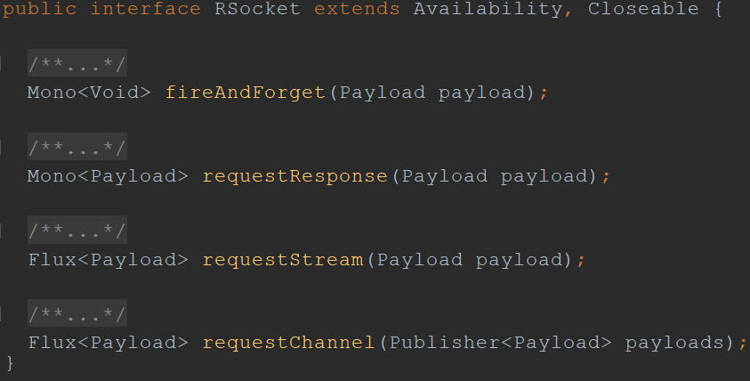
Rsocket (java) programming model

Slide 21
Rsocket programming model
RPC model
Spring style controller model

Slide 22
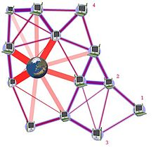
Rsocket flow control
Http vs Rsocket
Flow control over multiple hops

Slide 23
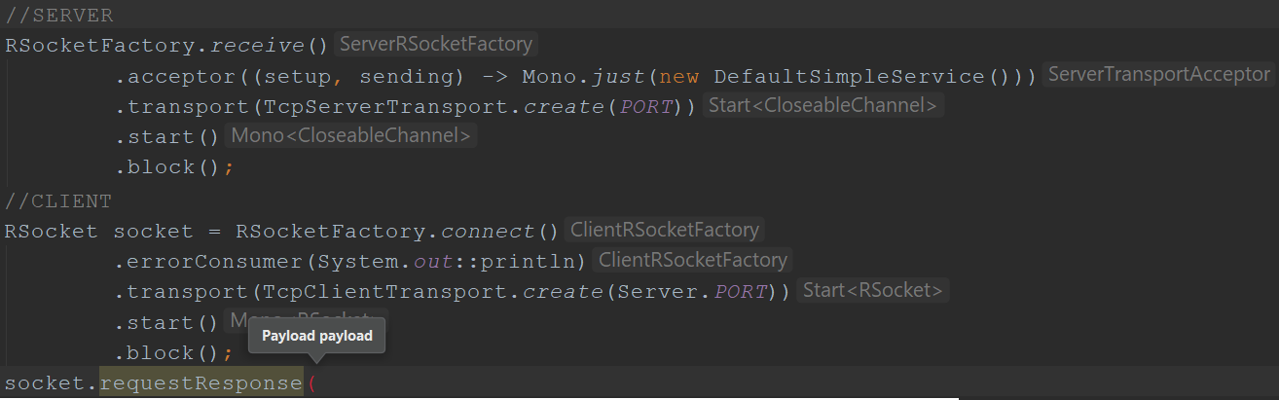
Rsocket example

Slide 24
Rsocket client server

Slide 25
Rsocket flow programm

